Slide 1
Model of Minesweeper
Square Class
Mines logic
Neighbour Count
Click interface

Slide 2
MinesweeperModel Class
1.Purpose
2.Variables to be used:
1.No. of rows-Integer
2.No. of cols-Integer
3.Static status defining variables:
1.Over-0
2.inProgress-1
3.Won-2
3.Constructor
public MinesweeperModel(int rows,int cols,int mines)

Slide 3
Square Class
1.Purpose
2.Attributes of Square class:
Rows-Integer
Cols-Integer
isMine-Boolean
isFlagged-Boolean
isOpen-Boolean
neighbourCount-Integer
3.Constuctor
public Square(int i, int j, boolean isMine)

Slide 4
Mines Logic And Neighbour Count
1.Allocate space for the board by
-Square board[][]=new Square[rows][cols];
2.Call the insertMines function as follows:
-public MinesweeperModel(int rows,int cols,int mines);
3.Calculate the neighbour count for each cell by using functions
-public void neighborCount();
-private int getNeighbourMinesCount(int i,int j);

Slide 5
Click Interface
Purpose
Function declaration
public int click(int i,int j);
Check specific conditions and return the corresponding value.
If the square is flagged already and if we left click it, it should return inprogress.
If the above is not the case, check if the square has a mine in it, if it has then return game over value.
Or else open all the neighbouring boxes’ mines count.

Slide 6
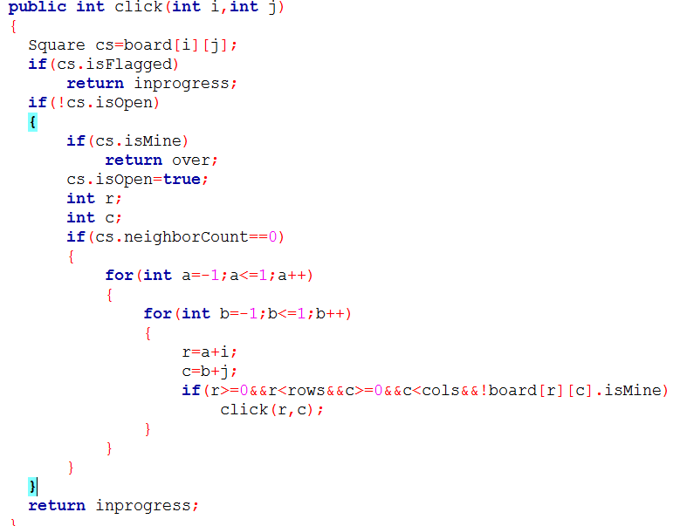
Click interface logic

Slide 7
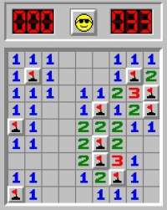
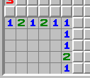
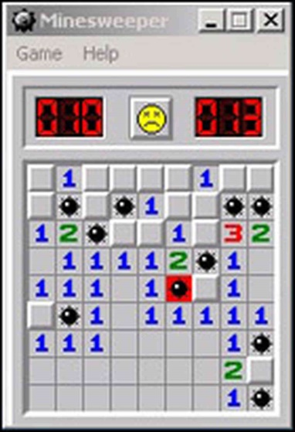
Status of the Game

Slide 8
Over to the next Presentation, Thank You!

